Slide 1

Doctor Visit Analysis
Data analytics Project

Slide 2
Agenda
1. Problem Statement
2. Description
3. Solution
4. EDA ( Data gathering, reading, cleaning,
preparing visualizing..)
5. Project market
6. End users
7. Value proposition
8. Result
9. Reference Links

Slide 3
Problem Statement/project Topic
Doctor Visit Analysis :
Analyze the impact of telemedicine on doctor visits and healthcare outcomes in a specific population.
Or
Identify factors influencing patient satisfaction with doctor visits and develop strategies to improve patient experience and satisfaction levels.

Slide 4

Description
This project focuses on understanding the factors that influence patient satisfaction with doctor visits and aims to develop strategies to improve the patient experience and satisfaction levels.

Slide 5
Solution
Patient satisfaction is a critical measure of healthcare quality and plays a significant role in patient retention, adherence to treatment plans, and overall healthcare outcomes.
Process:
1.Import the libraries & data
2.Explore the dataset
3. Find and replace missing values
4.Plot different plots and find co-relationships
b/w feature

Slide 6
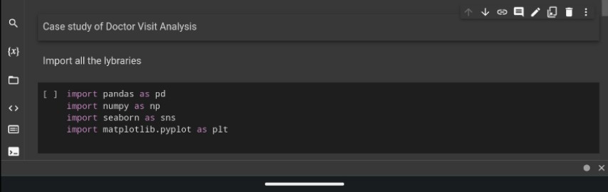

1.Import the libraries & data
2.Explore the dataset

Slide 7
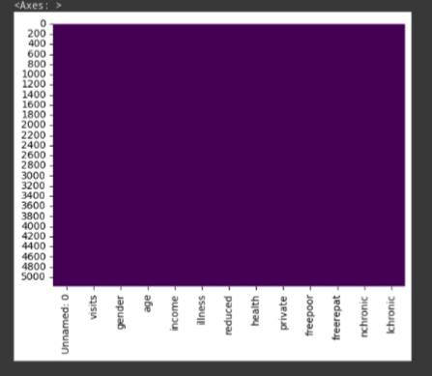
3. Finding & visualizing the missing values
Here we can observe there’s no missing values

Slide 8
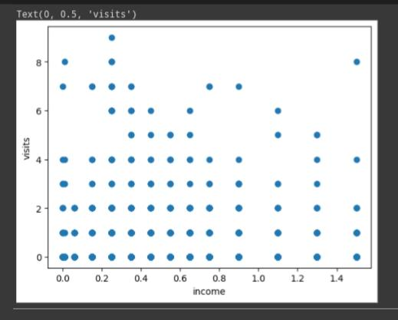
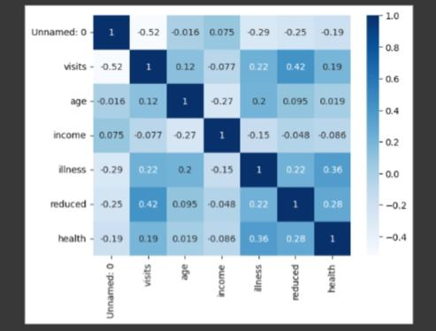
4. Co-relations between variables:
Here we can observe how illness is effect the visits of patients

Slide 9
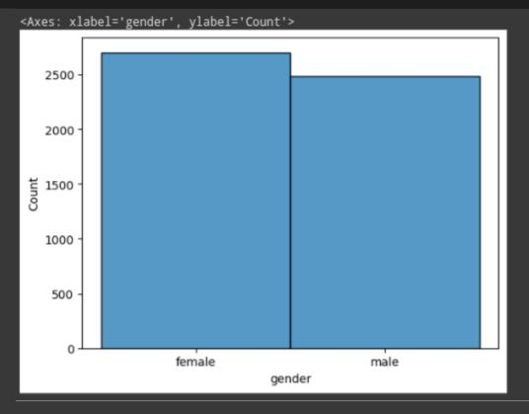
Visualizing results : No. Of males & females affected by illness
Here
More than 2500+ females are affected by illness
&
below 2500- males are affected by illness

Slide 10
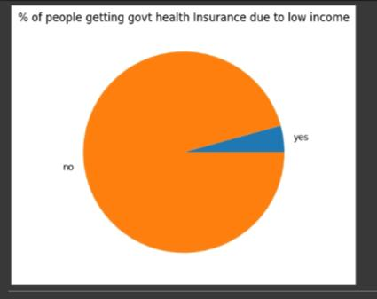
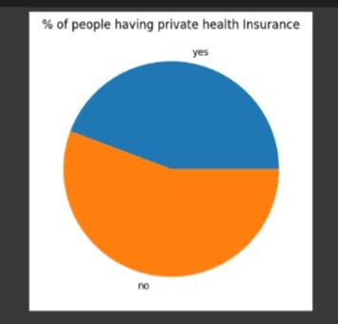
Here by observing
% of people getting govt Health Insurance due to low income
There are many people says ‘No’
i.e. they are not getting health insurance
Here many people have private health insurance

Slide 11
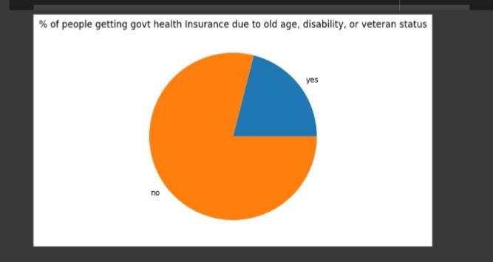
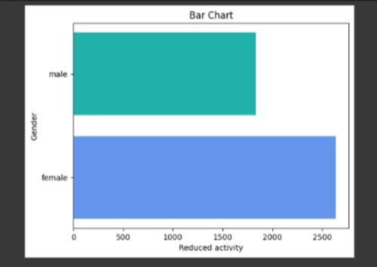
% Of people getting govt health insurance due to old age, disability & veteran status
Representation of horizontal bar chart to analyze the reduced days of activity due to illness based on Gender

Slide 12
Project market
Healthcare providers are constantly seeking ways to enhance operational efficiency and reduce costs. A doctor visit analysis project can provide valuable insights into patient trends, resource utilization, and bottlenecks in the healthcare system. This information can help healthcare organizations optimize their processes, reduce wait times, and allocate resources more effectively, ultimately leading to cost savings.
Overall, the demand for doctor visit analysis projects in the market is driven by the need for healthcare efficiency, improved patient experience, evidence-based decision making, population health management, and fostering research and innovation. Organizations that can offer comprehensive and insightful analysis in these areas are likely to find significant demand for their services.

Slide 13
END USERS
Healthcare Providers
Healthcare Administrators Healthcare IT Professionals
Healthcare Policy Makers Healthcare Researchers and Analysts
Doctors, nurses, and other healthcare professionals who directly interact with patients and make treatment decisions. They can utilize the analysis results. To improve patient care, optimize treatment plans, and enhance the overall healthcare experience.

Slide 14
Value Proposition
The Doctor Visit Analysis project uses data analytics to gain insights from doctor visit records. The goal is to improve healthcare outcomes and resource usage by identifying patterns and trends in the data.
We collect patient data, clean it, and analyze it to understand patient demographics, conditions, treatments, and outcomes.
Data visualizations help present the findings clearly.

Slide 15
Result
We able to understand the doctor’s visit to operate a person.
It makes a important role to understand patients satisfaction. By this we clearly know about visiting of doctor.
Doctor Visit Analysis is a necessity for healthcare professionals and medical institutions, because it helps to know about the patients, their illness, insurance, income etc.. & To empower the healthcare professionals with data-driven insights to improve patient care, enhance operational efficiency, and make more informed decisions in the realm of healthcare.

Slide 16
Links-
Project link
https://colab.research.google.com/drive/1R4rjLmtDj_5-tfAlnUOXcNl1OubiEqPK

